Slide 1
Climate Change Effects on Environmental Health in Vulnerable and Overburdened Communities
Yifan Yang, Ph.D. Student
Department of Geography, Texas A&M University
Instructor: Dr. Michael P. Bishop | Advisor: Dr. Lei Zou

Slide 2
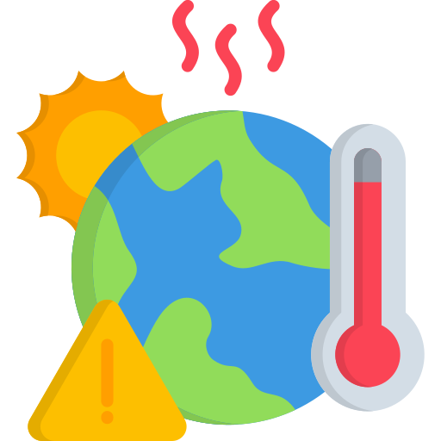







Introduction
Sea level rise
Climate disasters
Extreme weather patterns
Water Insecurity
Chemical Facilities and Utilities
Air Pollution
Climate Change
Health in overburdened communities
Near, Mid, and Long-term
(1) Climate change is exacerbating extreme weather, rising sea levels and climate disasters, particularly affecting the environment and health of vulnerable communities.
(2) Air pollution, water insecurity and industrial emissions
put these communities at higher risk of health problems such as asthma.

Slide 3

Nature of the Problem
The nature of the problem is that climate change has profound impacts on the environment and health of vulnerable communities through extreme climate events such as extreme heat, cold waves, sea level rise and climate disasters across multiple spatial and temporal scales.
These communities face greater environmental health risks due to exposure characteristics of their location such as proximity to industrial facilities, vulnerability to flooding or heat waves, and socioeconomic constraints.
At the same time, environmental problems such as air pollution and water insecurity show significant spatial inequality in different geographical regions and social groups.
After communicating with the advisor and reading the literature

Slide 4



Nature of the Problem
1) From a geographical perspective, the core of the problem lies in how the interaction between climate change and geospatial factors exacerbates health inequalities.
2) This spatial heterogeneity necessitates the use of comprehensive geospatial models to integrate variables such as climate change, land use, environmental exposure, and community vulnerability in order to quantify the compounded effects of these factors.
Provide scientific basis for local governments to formulate regional adaptation strategies
Regional Climate Models
Air Quality Models
Facility Resilience Models
Water Security Models
Geospatial Integration and Simulation

Slide 5


Previous Research
Jerrett et al. (2024): Vulnerable populations, climate change, public health, California, exposure, spatial models.
Ebi and Hess (2020): Health risks, climate change, inequities, environmental exposure, socioeconomic vulnerability.
Ebi et al. (2021): Extreme weather, climate change, public health, geographic disparities, vulnerable communities.
Khine and Langkulsen (2023): Climate impacts, vulnerable populations, South Africa, health risks, water security.
Astone and Vaalavuo (2023): Climate change, vulnerable groups, high temperatures, Finland, socioeconomic factors.
From the perspective of existing papers
from my perspective
Previous studies have mainly focused on individual aspects of climate change, such as air pollution, water security or infrastructure impacts, but lacked cross-disciplinary and multi-scale analysis. The main reason is that it is difficult to integrate data and models from different fields, especially across time and space scales.

Slide 6



Objectives
1. Develop an integrated geospatial model: Combine climate change, air pollution, water security, and community vulnerability data, employing methods like graph neural networks to quantify the compound impacts of these factors on the health of vulnerable communities.
2. Analyze health inequalities in overburdened communities: Utilize the developed model to reveal how climate change exacerbates health disparities in vulnerable populations.
Regional Climate Models
Air Quality Models
Water Security Models
Projected Health Disparities in Overburdened Communities
Facility Resilience Models
Geospatial Integration and Simulation
Exposure Response Models
Insecurity Response Models

Slide 7

Hypotheses
Hypothesis 1
Extreme heat from climate change combined with emissions from industrial facilities will increase the incidence of respiratory diseases (such as asthma and chronic obstructive pulmonary disease) in economically and environmentally vulnerable communities.
Hypothesis 2
The interaction between industrial pollution sources and increased wind speeds caused by climate change will expand the spread of air pollution in economically and environmentally vulnerable areas, increasing long-term health risks for residents.
Hypothesis 3
Heat and drought caused by climate change combined with water consumption from industrial facilities will increase water shortages and deteriorate water quality in economically and environmentally vulnerable communities.

Slide 8
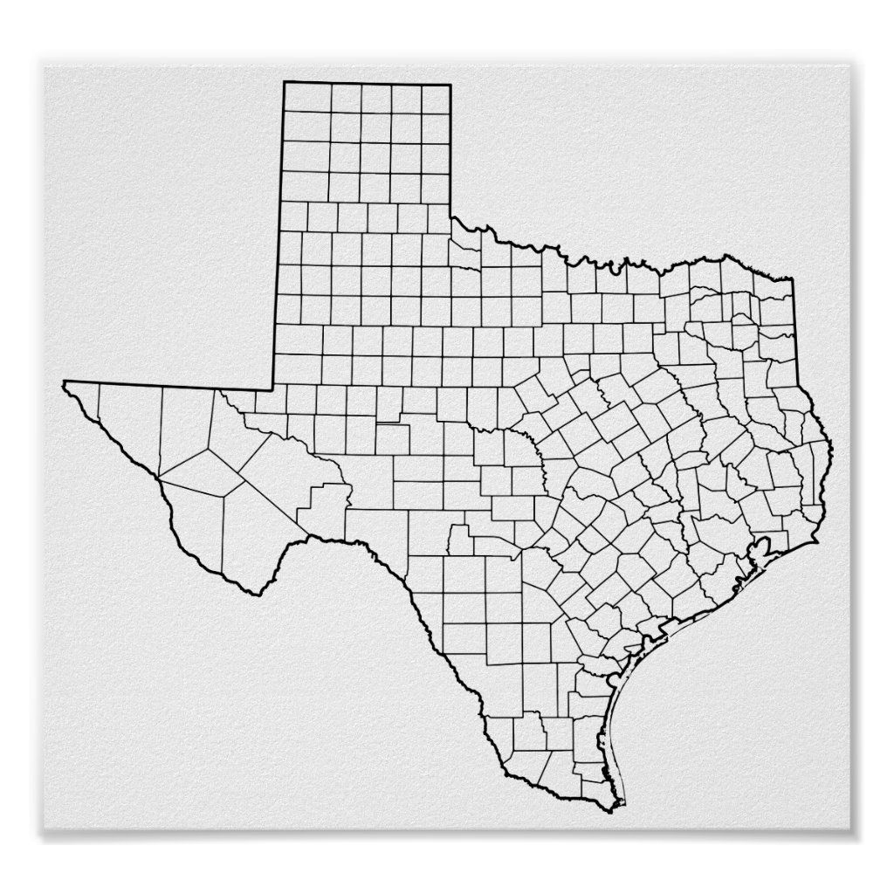


Study Area
Why we chose Texas as our research/study area?
Climate Vulnerability: Texas is highly susceptible to extreme weather events such as hurricanes, heat waves, droughts, and floods.
Geographically Diverse: Texas has a diverse landscape that provides a comprehensive setting for studying the interactions between climate change, air quality, and water security.
Industrial Presence: Texas has a large number of industrial facilities, including chemical plants and refineries, which contribute significantly to air and water pollution.
Vulnerable Populations: Many communities in Texas face socioeconomic vulnerabilities and lack access to healthcare and infrastructure.
Policy Relevance: Texas is a key state for U.S. energy and environmental policy.
Study Area：Texas

Slide 9

Research Assumptions
1) Climate Change and Extreme Weather Assumption：
Climate change will lead to an increase in the frequency and intensity of extreme weather events.
5) Socioeconomic vulnerability Assumption:
Communities with lower socioeconomic status have lower capacity to adapt to climate change due to limited resources and weak infrastructure.
2) Water Resource Security Assumption:
Climate change will exacerbate water scarcity and pollution problems.
4) Exposure-Response Assumption:
Long-term exposure to extreme weather events caused by air pollution and climate change leads to an increase in the incidence of chronic diseases.
3) Air Pollution and Climate Change Assumption:
Extreme weather conditions caused by climate change will work together with industrial emissions

Slide 10

Potential Research Issues
1) How ​​does the socioeconomic vulnerability of disadvantaged communities amplify the negative impacts of climate change on health inequality?
2) How to assess the long-term impact of climate change on critical infrastructure and its indirect impact on community health?
3) How ​​does the combined impact of climate change and extreme weather events on environmental health vary across different temporal and spatial scales?
4) How to more accurately predict the impact of climate change on future health outcomes through big data analysis and graph neural network models?

Slide 11
Reference
Jerrett, Michael, Rachel Connolly, Diane A. Garcia-Gonzales, Claire Bekker, Jenny T. Nguyen, Jason Su, Yang Li, and Miriam E. Marlier. "Climate change and public health in California: A structured review of exposures, vulnerable populations, and adaptation measures." Proceedings of the National Academy of Sciences 121, no. 32 (2024): e2310081121.
Ebi, Kristie L., and Jeremy J. Hess. "Health Risks Due To Climate Change: Inequity In Causes And Consequences: Study examines health risks due to climate change." Health Affairs 39, no. 12 (2020): 2056-2062.
Ebi, Kristie L., Jennifer Vanos, Jane W. Baldwin, Jesse E. Bell, David M. Hondula, Nicole A. Errett, Katie Hayes et al. "Extreme weather and climate change: population health and health system implications." Annual review of public health 42, no. 1 (2021): 293-315.
Khine, Myo Myo, and Uma Langkulsen. "The implications of climate change on health among vulnerable populations in South Africa: a systematic review." International Journal of Environmental Research and Public Health 20, no. 4 (2023): 3425.
Astone, Roberto, and Maria Vaalavuo. "Climate change and health: Consequences of high temperatures among vulnerable groups in Finland." International Journal of Social Determinants of Health and Health Services 53, no. 1 (2023): 94-111.

